Slide 1

Chapter 3.5
Markov State Process
Performance Evaluation of the Internet of Things (IoT)
Module Course: Performance Evaluation of Distributed Systems
Prof. Tobias Hoßfeld, Summer Semester 2022

Slide 2
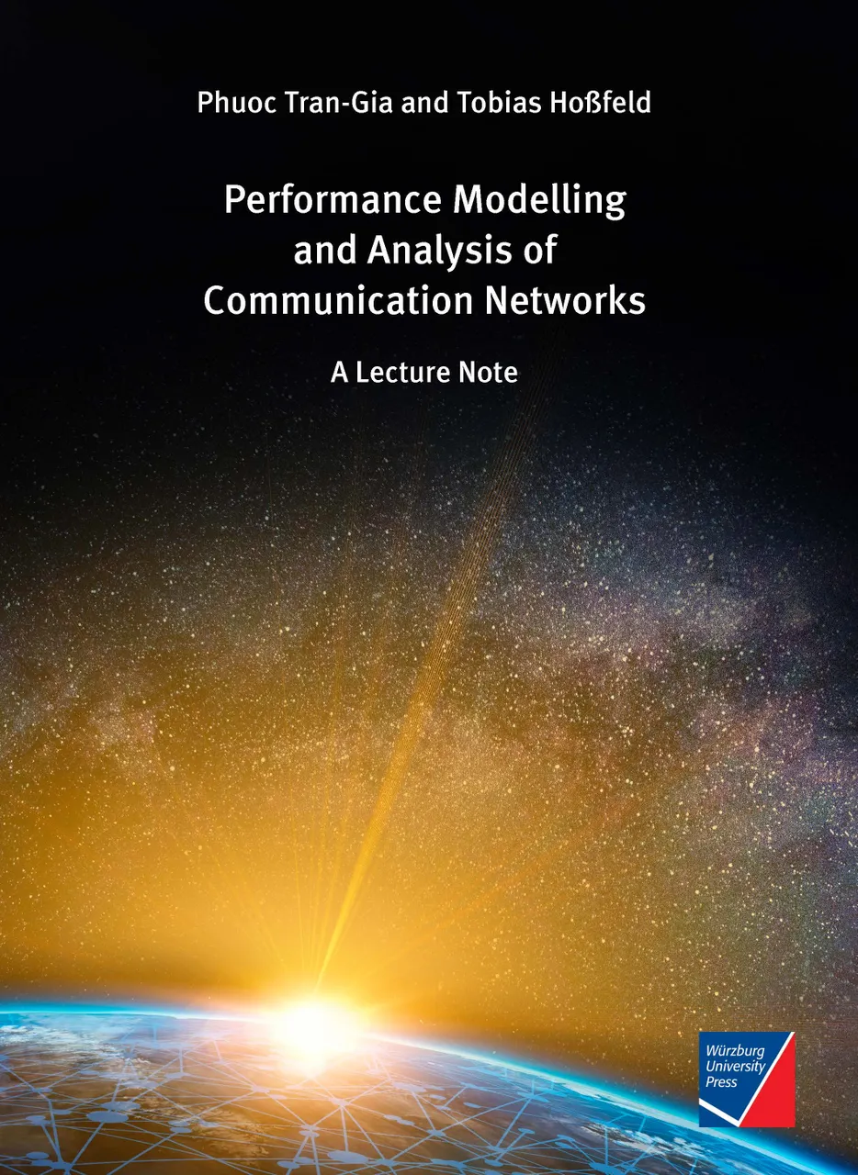
Disclaimer and Copyright Notice
Lecture slides, figures, and scripts are based on the open access text book “Performance Modeling and Analysis of Communication Networks”. The book and scripts are licensed under the Creative Commons License Attribution-ShareAlike 4.0 International (CC BY-SA 4.0). If you remix, transform, or build upon the material, you must distribute your contributions under the same license as the original.
The book must be cited and the disclaimer attached when using lectures slides or scripts.
Tran-Gia, P. & Hossfeld, T. (2021). Performance Modeling and Analysis of Communication Networks - A Lecture Note. Würzburg University Press. https://doi.org/10.25972/WUP-978-3-95826-153-2
Website to download book, exercises, slides and scripts: https://modeling.systems/

Slide 3
Chapter 3
3 Elementary Random Processes
3.1 Stochastic Processes
3.1.1 Definition
3.1.2 Markov Processes
3.1.3 Elementary Processes in Performance Models
3.2 Renewal Processes
3.2.1 Definition
3.2.2 Analysis of Recurrence Time
3.3 Poisson Process
3.3.1 Definition of a Poisson Process
3.3.2 Properties of the Poisson Process
3.3.3 Poisson Arrivals during Arbitrarily Distributed Interval
3.4 Superposition of Independent Renewal Processes
3.4.1 Superposition of Poisson Processes
3.4.2 Palm-Khintchine Theorem
3.5 Markov State Process
3.5.1 Definition of Continuous-Time Markov Chain
3.5.2 Transition Behavior of Markovian State Processes
3.5.3 State Equations and State Probabilities
3.5.4 Examples of Transition Probability Densities
3.5.5 Birth-and-Death Processes

Slide 4
Definition of Continuous-Time Markov Chain

Slide 5
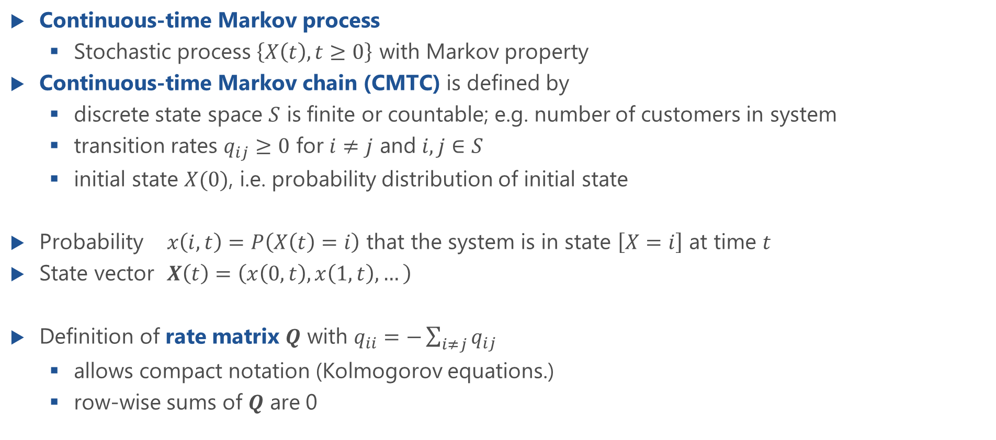
Continuous-Time Markov Chain (CTMC)
Continuous-time Markov process
Stochastic process $\left\{X\left(t\right),t≥0\right\}$ with Markov property
Continuous-time Markov chain (CMTC) is defined by
discrete state space $S$ is finite or countable; e.g. number of customers in system
transition rates $q_{ij}≥0$ for $i≠j$ and $i,j∈S$
initial state $X(0)$, i.e. probability distribution of initial state
Probability $x\left(i,t\right)=P\left(X\left(t\right)=i\right)$ that the system is in state $\left[X=i\right]$ at time $t$
State vector $X\left(t\right)=\left(x\left(0,t\right),x\left(1,t\right),…\right)$
Definition of rate matrix $Q$ with $q_{ii}=−\sum_{i≠j}{q_{ij}}$
allows compact notation (Kolmogorov equations.)
row-wise sums of $Q$ are 0

Slide 6
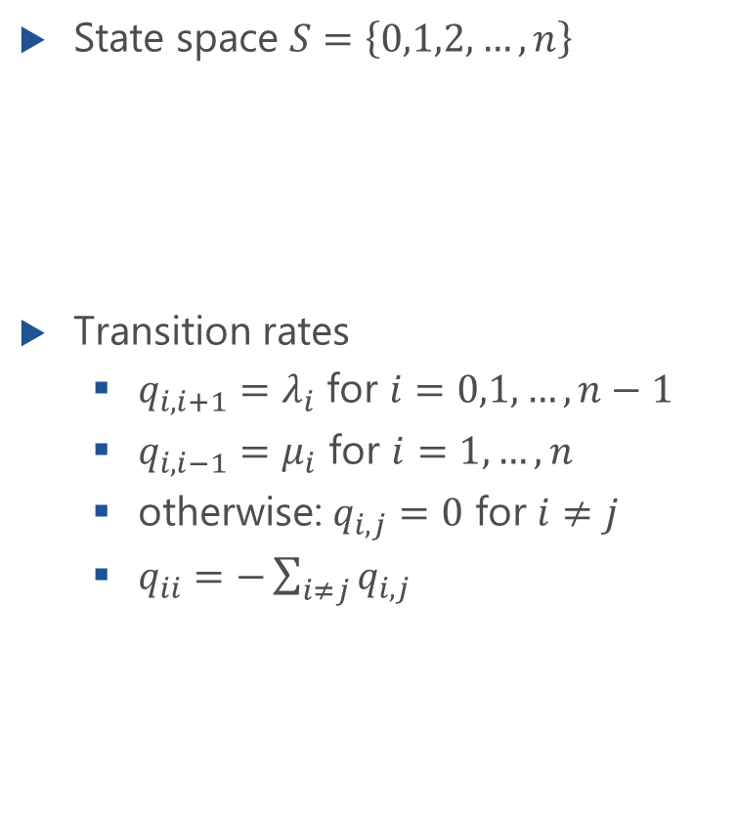
Illustration of CTMC: Example
State space $S=\left\{0,1,2,…,n\right\}$
Transition rates
$q_{i,i+1}=λ_{i}$ for $i=0,1,…,n−1$
$q_{i,i−1}=μ_{i}$ for $i=1,…,n$
otherwise: $q_{i,j}=0$ for $i≠j$
$q_{ii}=−\sum_{i≠j}{q_{i,j}}$
Transition matrix

Slide 7
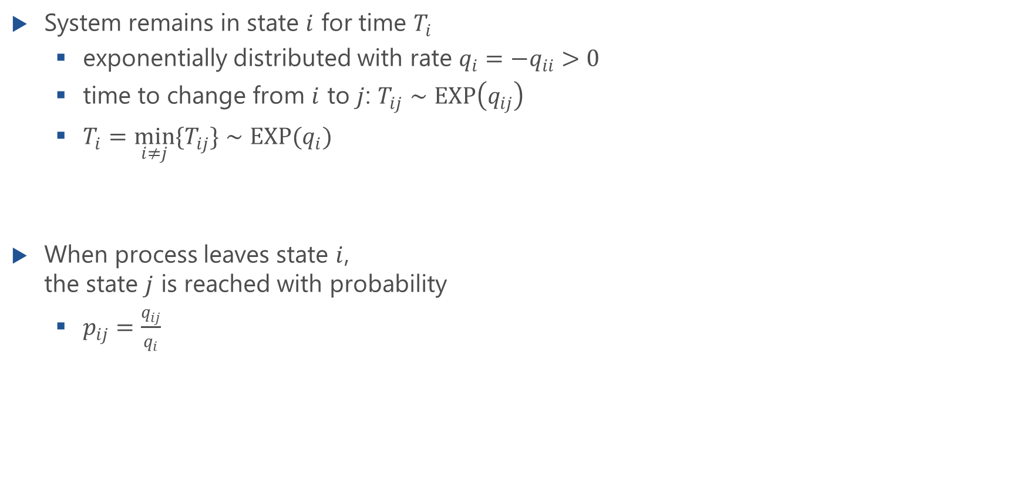
Transition Behavior of CTMC
System remains in state $i$ for time $T_{i}$
exponentially distributed with rate $q_{i}=−q_{ii}>0$
time to change from $i$ to $j$: $T_{ij}∼EXP\left(q_{ij}\right)$
$T_{i}=\min_{i≠j}\{T_{ij}\}{∼EXP(q_{i}) }$
When process leaves state $i$, the state $j$ is reached with probability
$p_{ij}=\frac{q_{ij}}{q_{i}}$

Slide 8
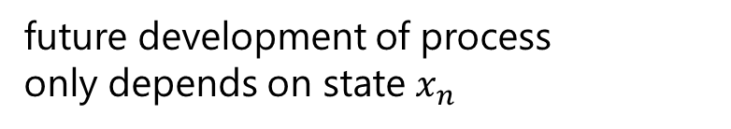
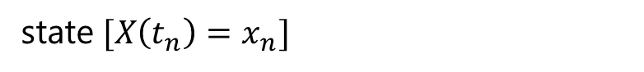
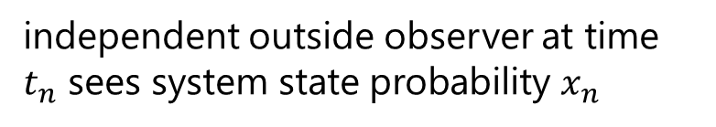
Analysis of Continuous-time Markov Chain (CMTC)
independent outside observer at time $t_{n}$ sees system state probability $x_{n}$
X(t)
x
n
i
i
2
1
0
t
x(i)
t
n
state$[X\left(t_{n}\right)=x_{n}]$
future development of process only depends on state $x_{n}$
x
n

Slide 9
Overview on the Analysis
Markov state process and memoryless property
Homogeneous systems: transition probabilities independent of time instant
Chapman-Kolmogorov equation for state transition probabilities:
Kolmogorov forward equation for probability densities
Kolmogorov forward equation for state probabilities
Stationary system
Example: birth-and-death process

Slide 10
Transition Behavior of Markovian State Processes
Chapman-Kolmogorov equation

Slide 11
Transition Behavior of Markovian State Processes

Slide 12
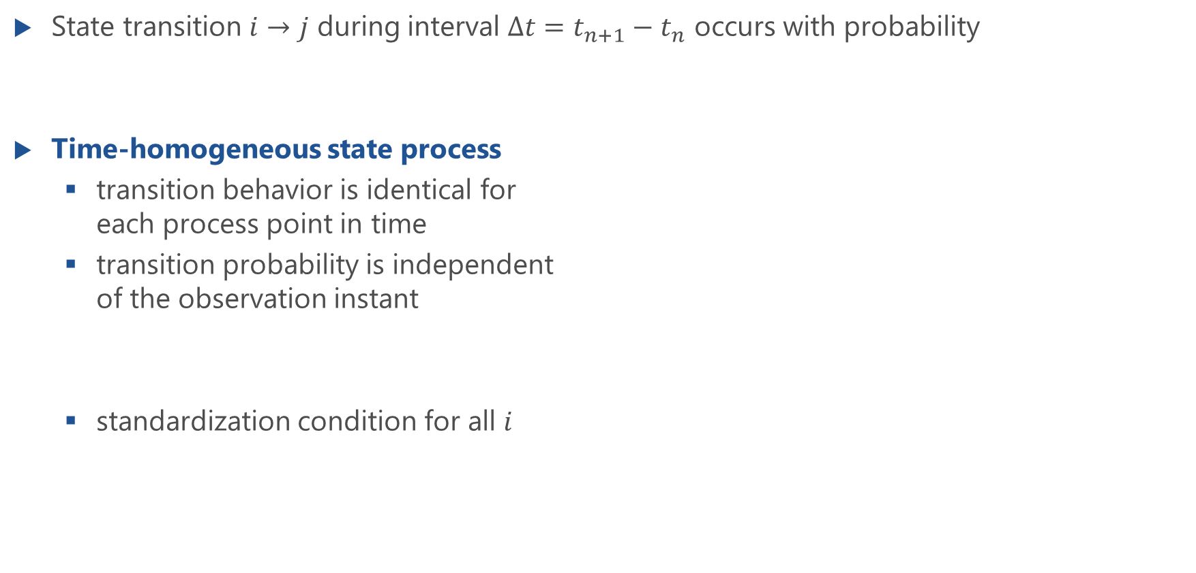
Transition Probability
State transition $i→j$ during interval $Δt=t_{n+1}−t_{n}$ occurs with probability
Time-homogeneous state process
transition behavior is identical for each process point in time
transition probability is independent of the observation instant
standardization condition for all $i$

Slide 13
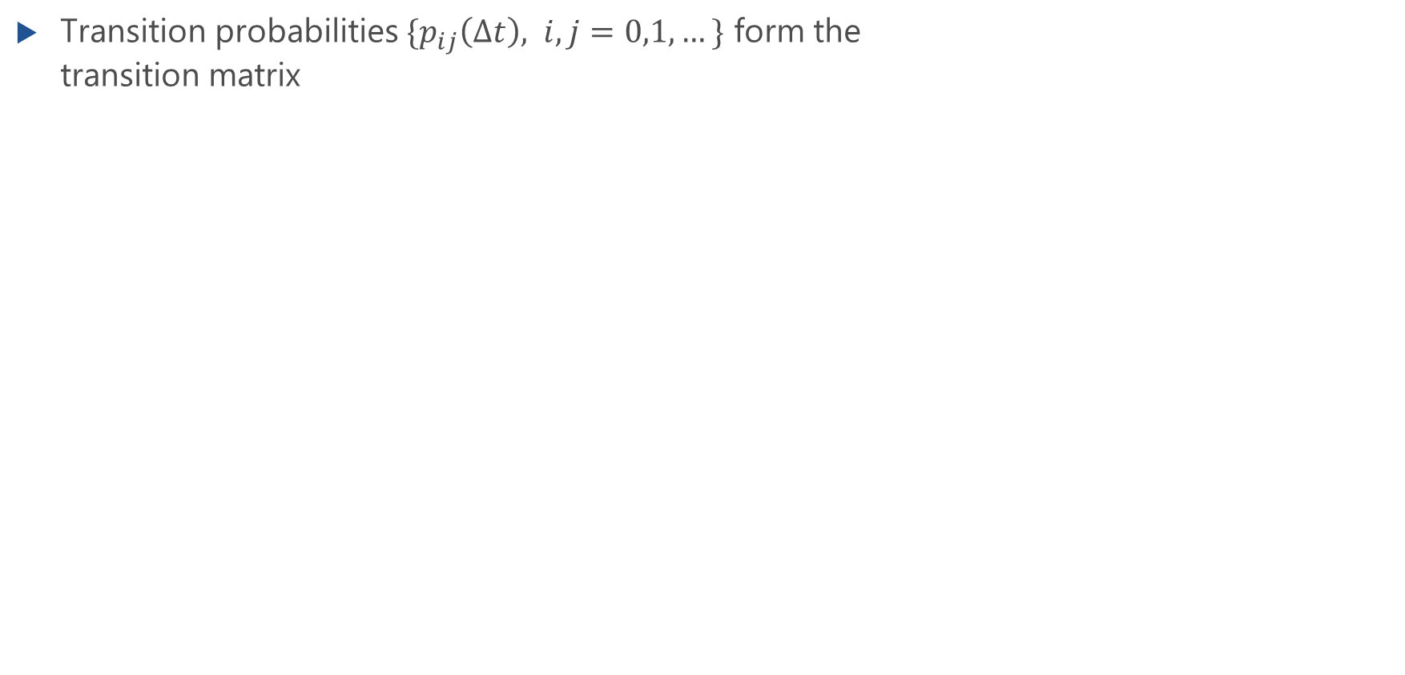
Transition Matrix
Transition probabilities $\{p_{ij}\left(Δt\right), i,j=0,1,…\}$ form the transition matrix
p (
Δ
t)
i
ij
j
2
1
0
0
Δ
t

Slide 14
Chapman-Kolmogorov Equation
or

Slide 15
Chapman-Kolmogorov Equation (f.)
Lecture

Slide 16
Kolmogorov Forward Equation for Transition Probabilities

Slide 17
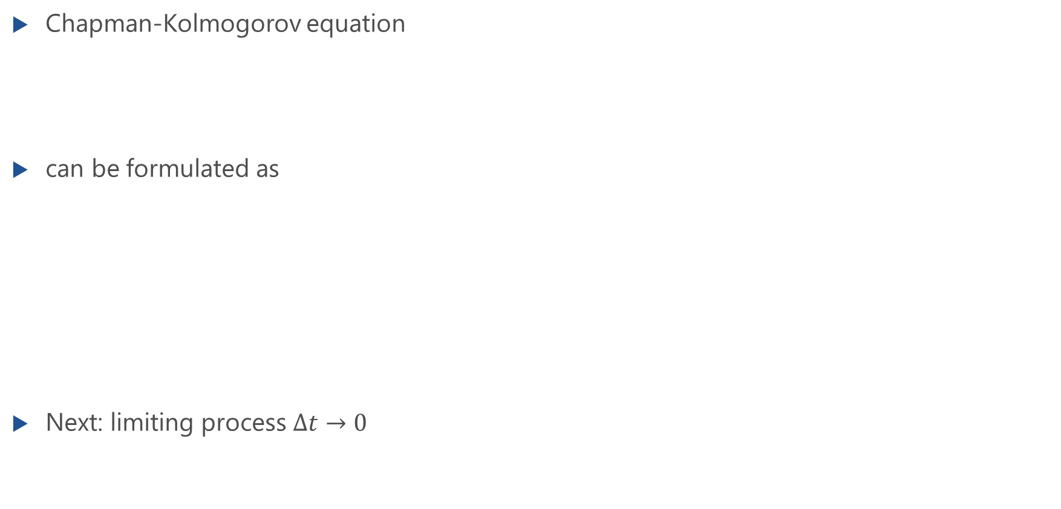
Kolmogorov Forward Equation for Transition Probabilities
Chapman-Kolmogorov equation
can be formulated as
Next: limiting process $Δt→0$

Slide 18
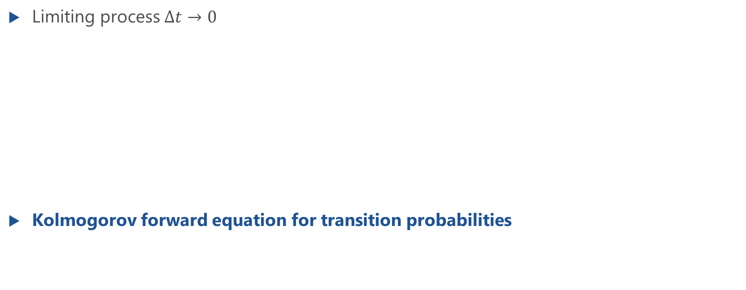
Kolmogorov Forward Equation: Limiting Process
Limiting process $Δt→0$
Kolmogorov forward equation for transition probabilities
first derivative of transition probabilities $p_{ij}(t)$at time $t$
transition probability density for the transition $k→j$
transition probability density for leaving the state $j$

Slide 19
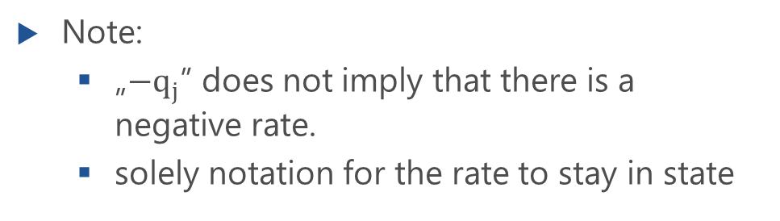
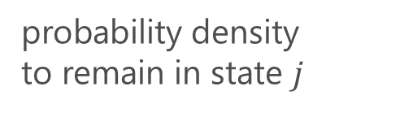
Kolmogorov Forward Equation: Matrix Notation
Kolmogorov forward equation for transition probabilities
Matrix for transition probability densities is defined
with
row-wise sum is 0
and
probability density
to remain in state $j$
Note:
„$−q_{j}$” does not imply that there is a negative rate.
solely notation for the rate to stay in state

Slide 20
Solution of Kolmogorov Forward Equation
Kolmogorov forward equation for transition probabilities in matrix notation
Solution requires the computation of the matrix exponential of the matrix
See notebook script “3.5 Markov processes: nonstationary and stationary analysis [ipynb]” https://modeling.systems/

Slide 21
State Equations and State Probabilities
Kolmogorov Forward Equation for State Probabilities

Slide 22
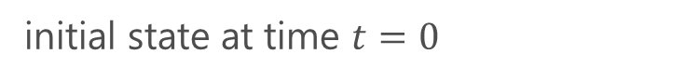
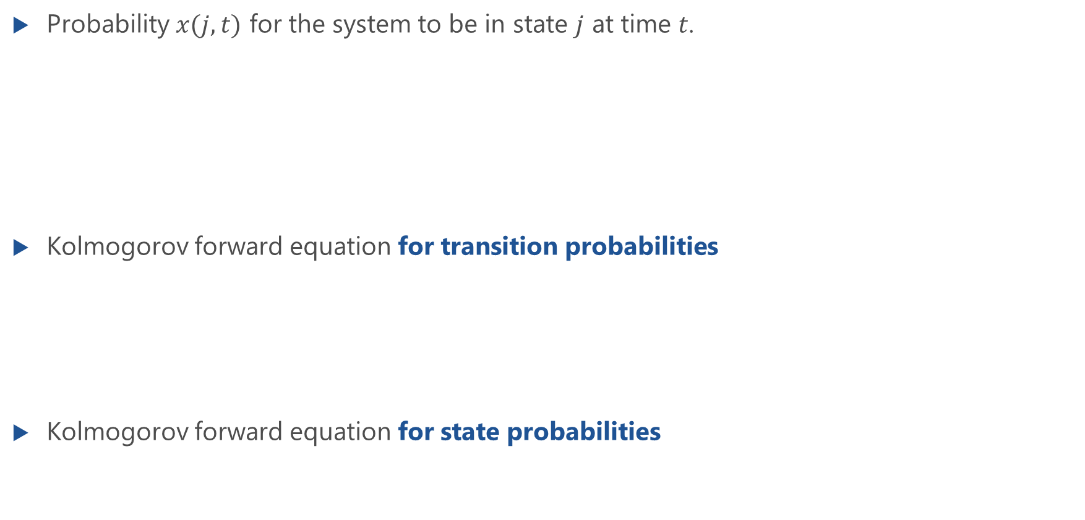
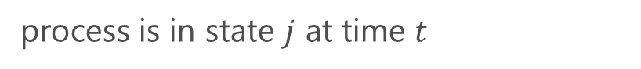
Kolmogorov Forward Equation for State Probabilities
Probability $x(j,t)$ for the system to be in state $j$ at time $t$.
Kolmogorov forward equation for transition probabilities
Kolmogorov forward equation for state probabilities
process is in state $j$ at time $t$
initial state at time $t=0$

Slide 23
Kolmogorov Forward Eq. for State Probabilities: Matrix Notation
Kolmogorov forward equation for state probabilities is system of differential equations
State probabilities as vector
Initial state and transition probability matrix
Matrix notation of Kolmogorov forward equation for state probabilities

Slide 24
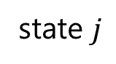
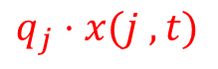
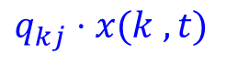
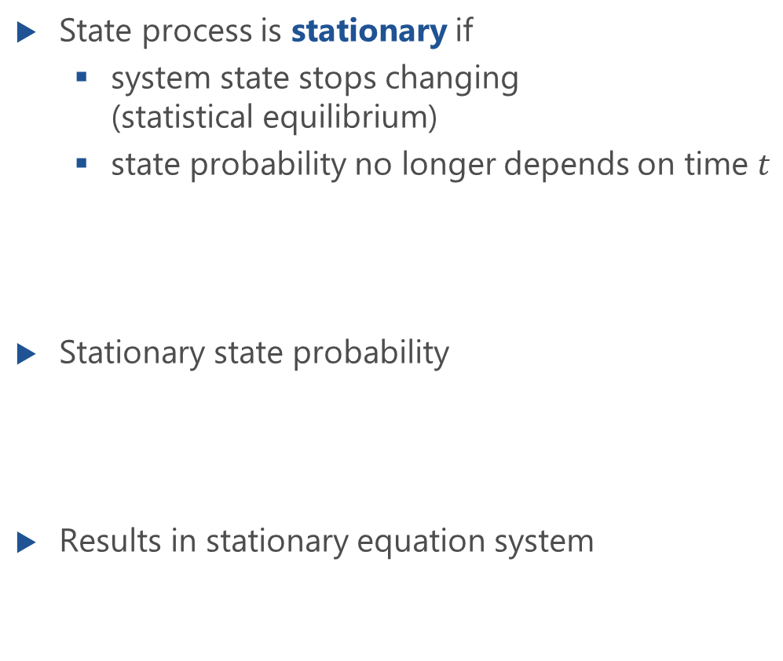
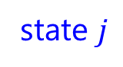
Stationary State Probabilities
State process is stationary if
system state stops changing (statistical equilibrium)
state probability no longer depends on time $t$
Stationary state probability
Results in stationary equation system
state $j$
k
$$q_{kj}⋅x(k ,t)$$
2
1
0
$$q_{j}⋅x(j ,t)$$
reaching state j
state $j$
leaving state j

Slide 25
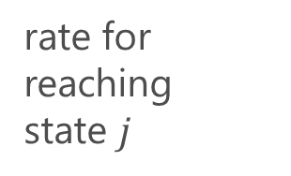
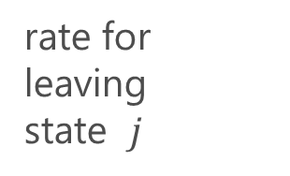
Principle of Maintaining Statistical Equilibrium
rate for leaving state $j$
rate for reaching state $j$
=
Principle of maintaining statistical equilibrium
Stationary system: flows of weighted probability densities for reaching and leaving a state must be in equilibrium, i.e., they are the same
state probability no longer changes in time

Slide 26
Stationary Equation System: Matrix Notation
state $j$
k
$$q_{kj}⋅x(k ,t)$$
2
1
0
$$q_{j}⋅x(j ,t)$$
rate for leaving state $j$
rate for reaching state $j$
reaching state j
state $j$
leaving state j
=
Stationary state probability vector
State equation system

Slide 27
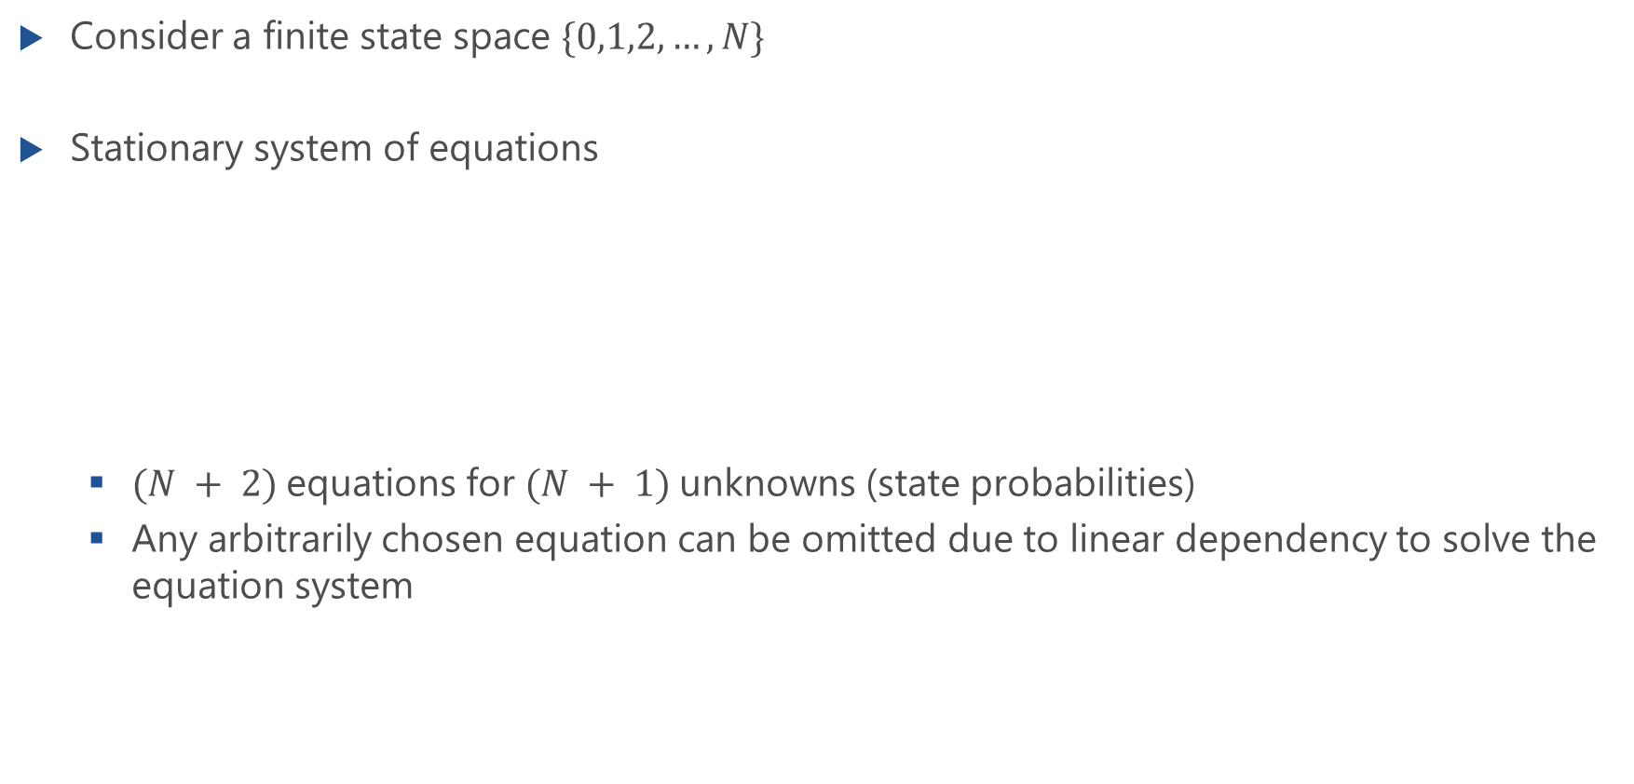
Linear Dependency of State Equations
Consider a finite state space $\{0,1,2,…,N\}$
Stationary system of equations
$(N + 2)$equations for $(N + 1)$unknowns (state probabilities)
Any arbitrarily chosen equation can be omitted due to linear dependency to solve the equation system

Slide 28
Macro States
Single state that cannot be further decomposed is also called a micro state
Combination of any set of micro states leads to a macro state
Example
Appropriate choice of macro states often provides simpler system of equations for computing the (micro) state probabilities

Slide 29
Global Equilibrium Equation
State equation for an arbitrary macro state
Relates transition probability densities between a macro state and rest in the state space
Global equilibrium equations are also referred to as full or global balance equations

Slide 30
Example: Stationary State Equations
Lecture

Slide 31
Example: Stationary Macro State Equations
Lecture

Slide 32
Summary: Stationary Equation System
Lecture

Slide 33
Examples of Transition Probability Densities

Slide 34
Transition Probability Densities
What is the transition probability density of a Markov state process?
Example: M/M/n-0
transition rates of a Poisson process?
model
arrival process
Markov
state process
X(t)

Slide 35
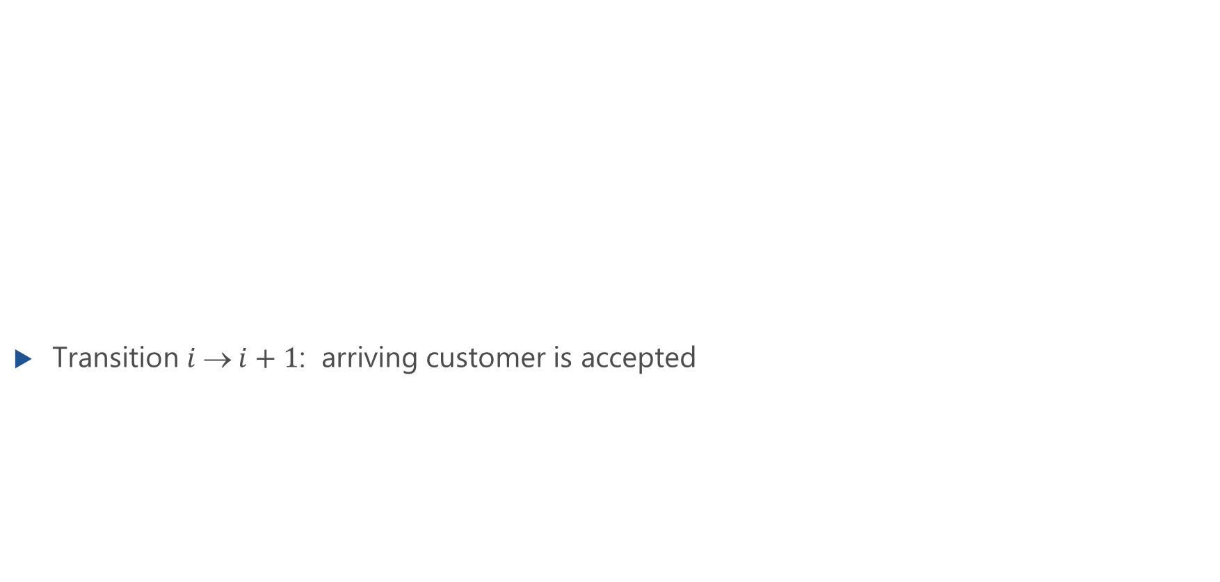
Transition Probability Density of Poisson Arrival Process
Transition $i  i+1$: arriving customer is accepted
$$p_{i,i+1}\left(dt\right)=P(X\left(t+dt\right)=i+1|X\left(t\right)=i)$$

Slide 36
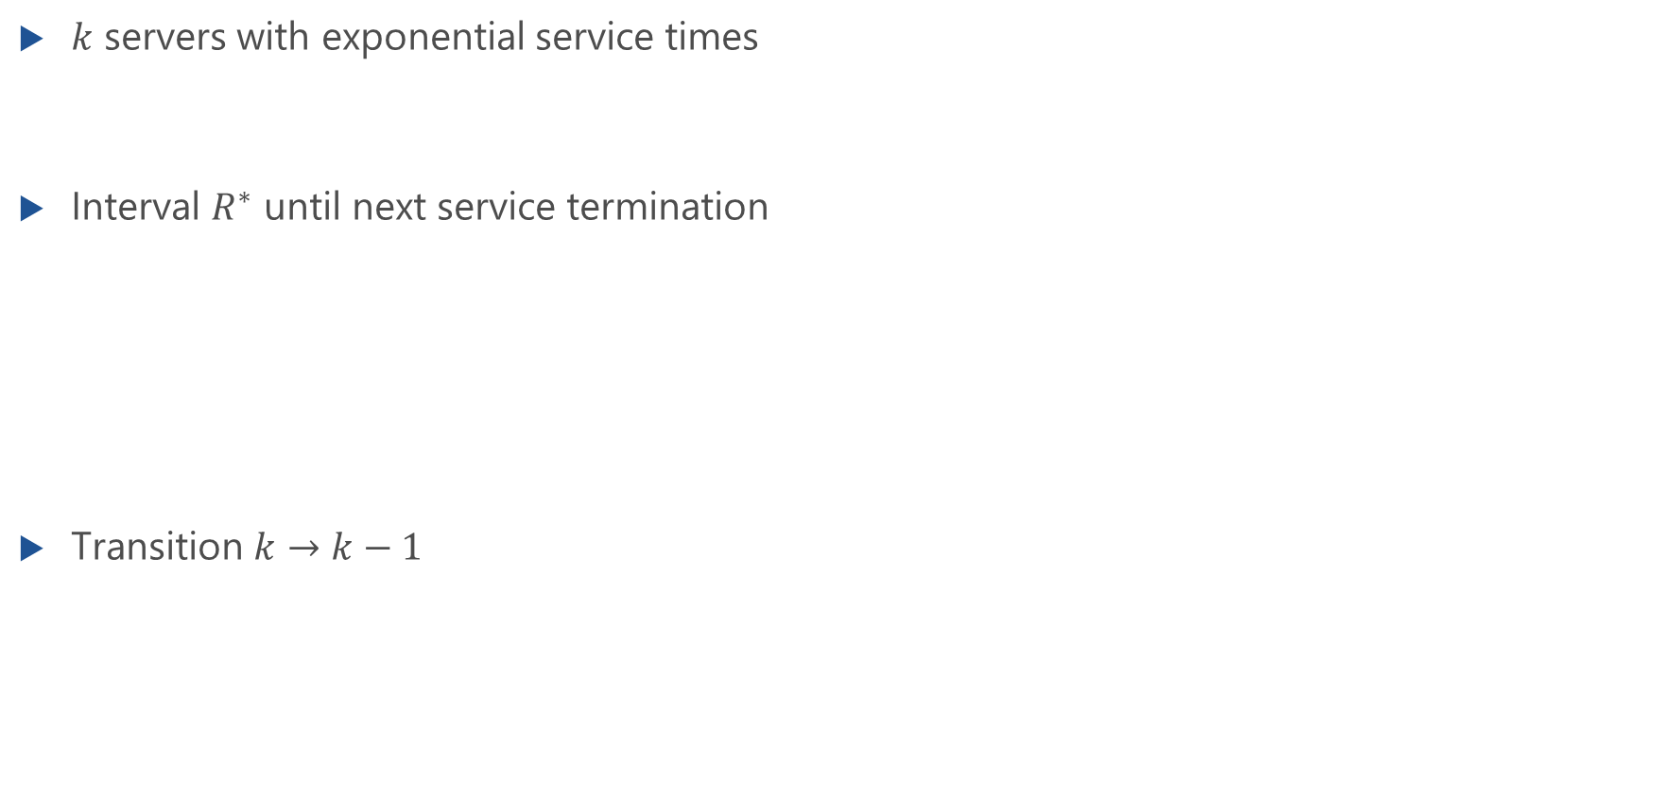
Transition Probability Density for Exponential Service Time
$k$ servers with exponential service times
Interval $R^{∗}$ until next service termination
Transition $k→k−1$

Slide 37
Birth-and-Death Processes

Slide 38
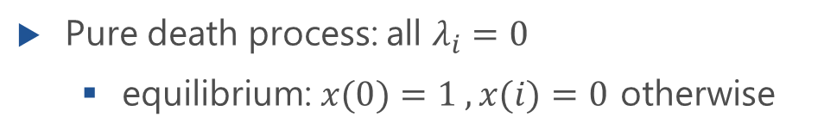
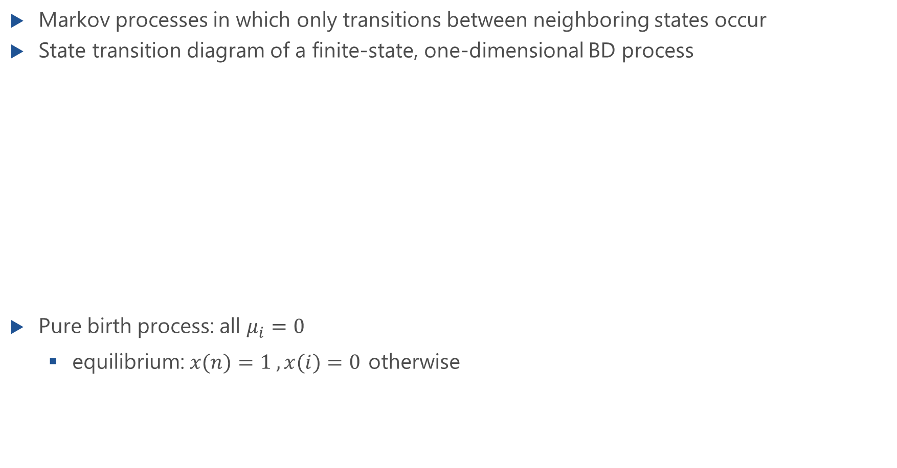
Birth-and-Death Processes
Markov processes in which only transitions between neighboring states occur
State transition diagram of a finite-state, one-dimensional BD process
Pure birth process: all $μ_{i}=0$
equilibrium: $x(n)=1 , x(i)=0$ otherwise
Pure death process: all $λ_{i}=0$
equilibrium: $x(0)=1 , x(i)=0$ otherwise

Slide 39
Example: No BD Process
Lecture

Slide 40
Non-stationary Birth-and-Death Processes
Transient (time-dependent) state probabilities of the BD process
Solution of this differential equation system with the initial conditions
Example: Poisson Process as pure birth process

Slide 41
Example: Poisson Process as Pure Birth Process

Slide 42
Stationary Birth-and-Death Processes
Equation system for the micro states of the state space
because of linear dependency, one of these equations can be omitted

Slide 43
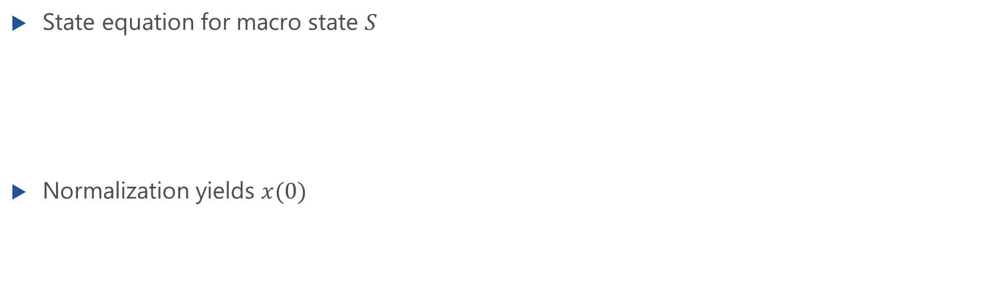
Macro State Equation System
State equation for macro state $S$
Normalization yields $x(0)$

Slide 44
Solving the Macro State Equation System
Lecture

Slide 45
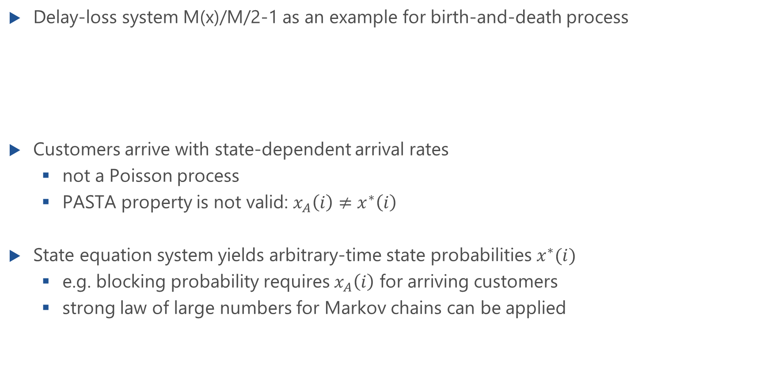
Example: Delay-Loss System with State-dependent Rates
Delay-loss system M(x)/M/2-1 as an example for birth-and-death process
Customers arrive with state-dependent arrival rates
not a Poisson process
PASTA property is not valid: $x_{A}\left(i\right)≠x^{∗}\left(i\right)$
State equation system yields arbitrary-time state probabilities $x^{∗}(i)$
e.g. blocking probability requires $x_{A}\left(i\right)$ for arriving customers
strong law of large numbers for Markov chains can be applied

Slide 46
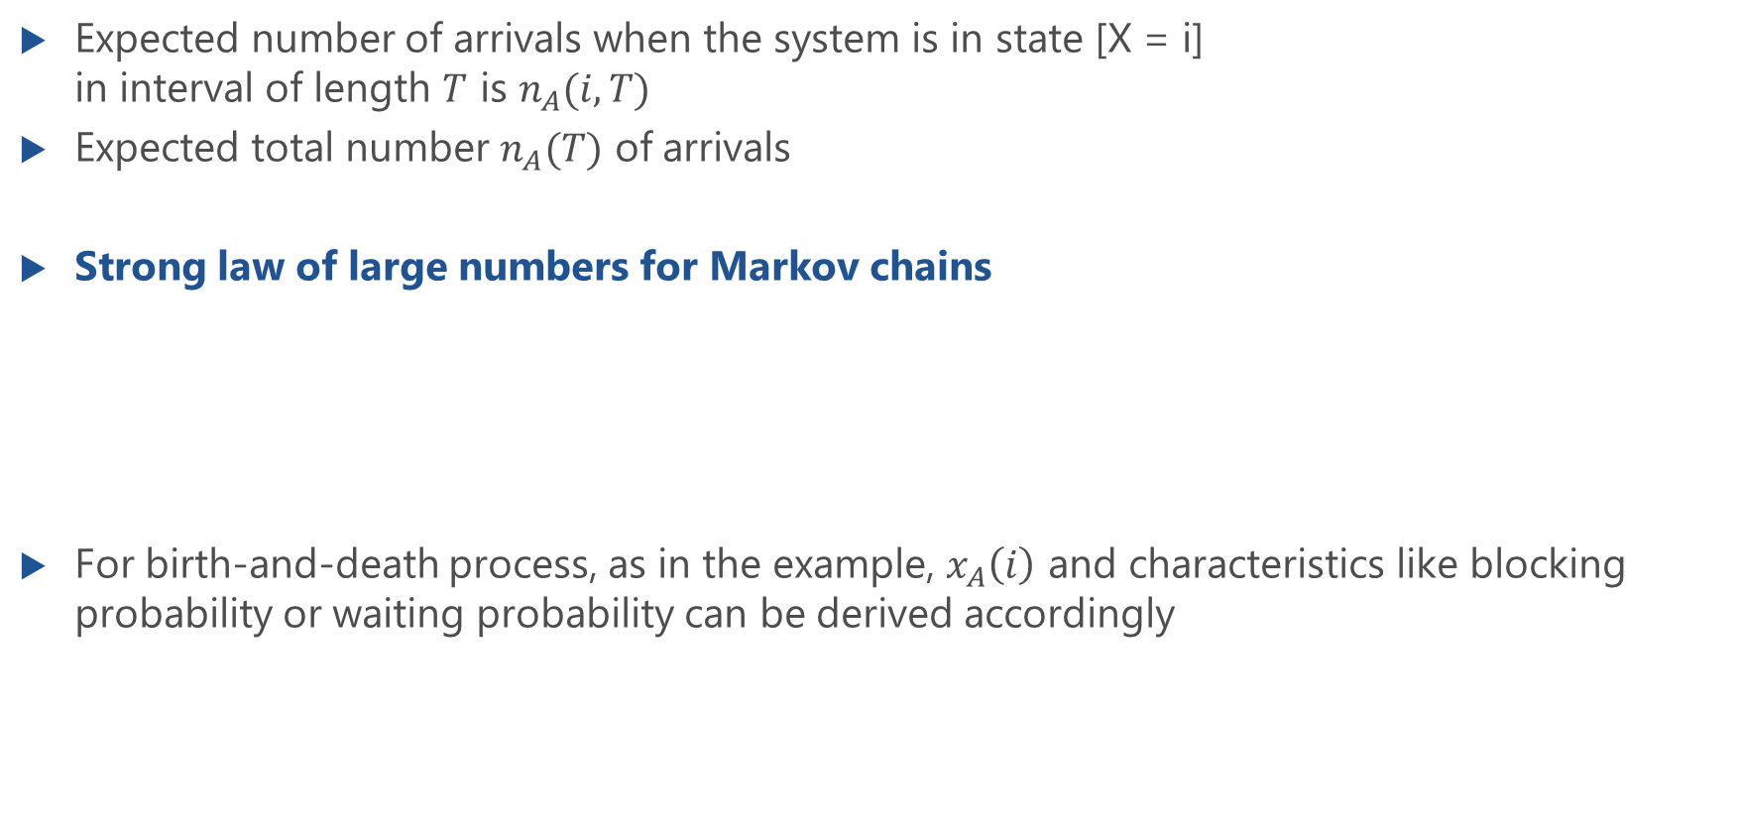
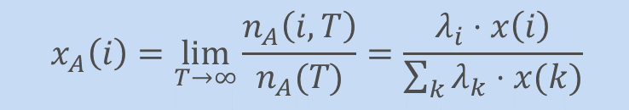
Strong Law of Large Numbers for Markov Chains
Expected number of arrivals when the system is in state [X = i] in interval of length $T$ is $n_{A}(i,T)$
Expected total number $n_{A}(T)$ of arrivals
Strong law of large numbers for Markov chains
For birth-and-death process, as in the example, $x_{A}\left(i\right)$ and characteristics like blocking probability or waiting probability can be derived accordingly
$$x_{A}\left(i\right)=\lim_{T→∞}{\frac{n_{A}\left(i,T\right)}{n_{A}(T)}=\frac{λ_{i}⋅x\left(i\right)}{\sum_{k}{λ_{k}⋅x(k)}}}$$

